Slide 1


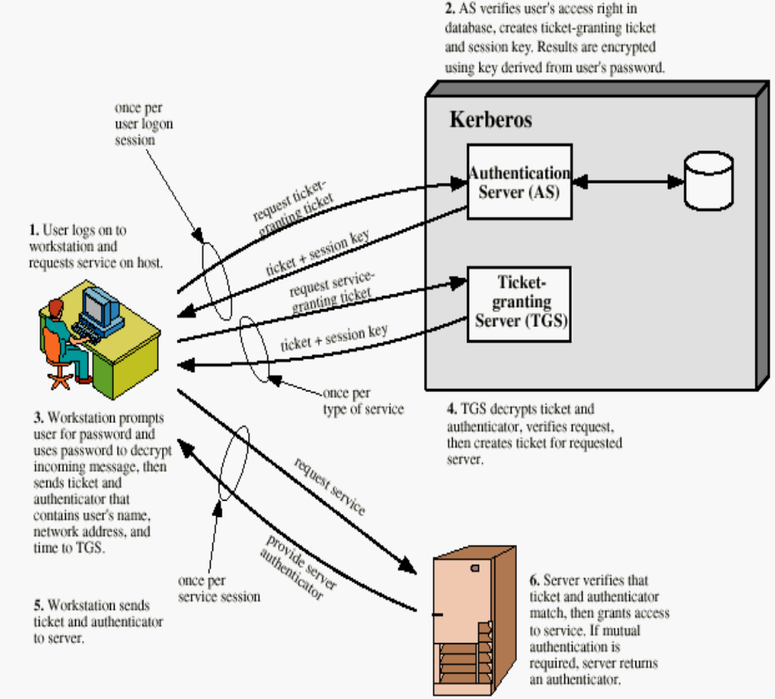
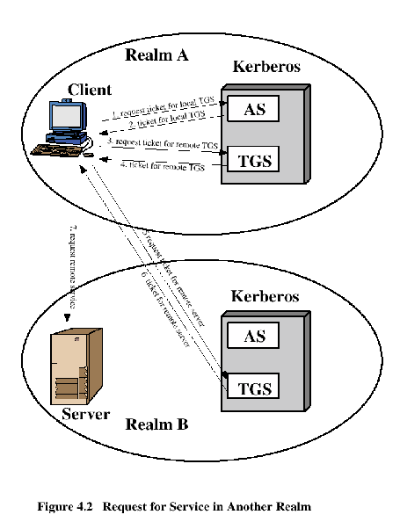
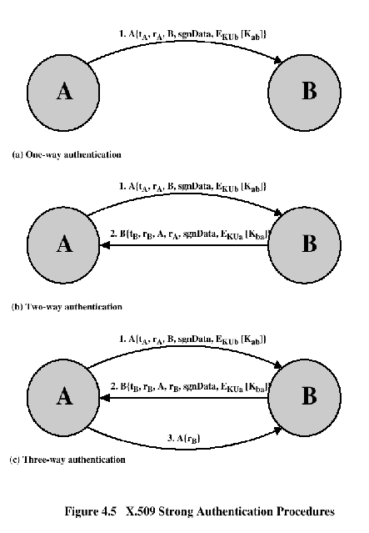
KERBEROS
Centralized Authentication Application
In Greek Mythology, a many headed dog, the guardian of the entrance of Hades
Names: Abiha, Sabika, Maria Nasir, Aoun Instructor: Asima Nisar
What is Kerberos
Provides a centralized authentication server to authenticate users to servers & servers to users.
No use of public key encryption
Why Kerberos
3 threads:
User pretend to be another user.
User alter the network address of a workstation
User eavesdrop on exchanges & use a replay attack
.
Kerberos Realm
A single administrative domain includes:
A Kerberos Server
A number of clients, all registered with server
Application Servers, sharing keys with server
Kerberos V.5 Properties
Realm
Options
Times
Nonce
Subkey
Sequence Number
Interrealm Authentication
Kerberos server in each realm shares a secret key with server in other realms.
It requires Kerberos server in one realm should trust the one in other realm to authenticate its users & trusts the Kerberos server in the first realm.
Kerberos:Strengths
Kerberos has been scrutinized by many of the top programmers, cryptologists and security experts in the industry
Secret keys are only passed across the network in encrypted form..
Client and Server systems mutually authenticate.
X.509 Services
Distributed set of servers that maintains a database about users.
Each certificate contains the public key of a user and is signed with the private key of a CA.
Used in S/MIME, IP Security, SSL/TLS and SET.

